Slide 1
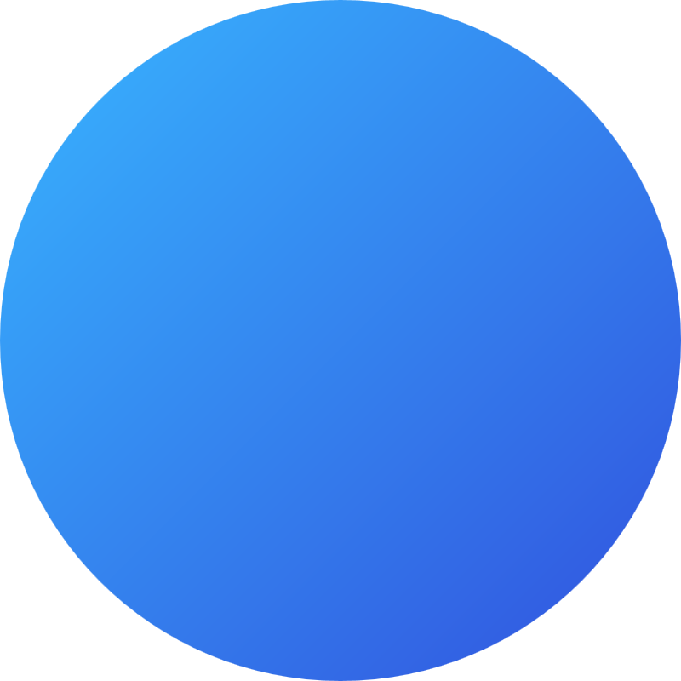

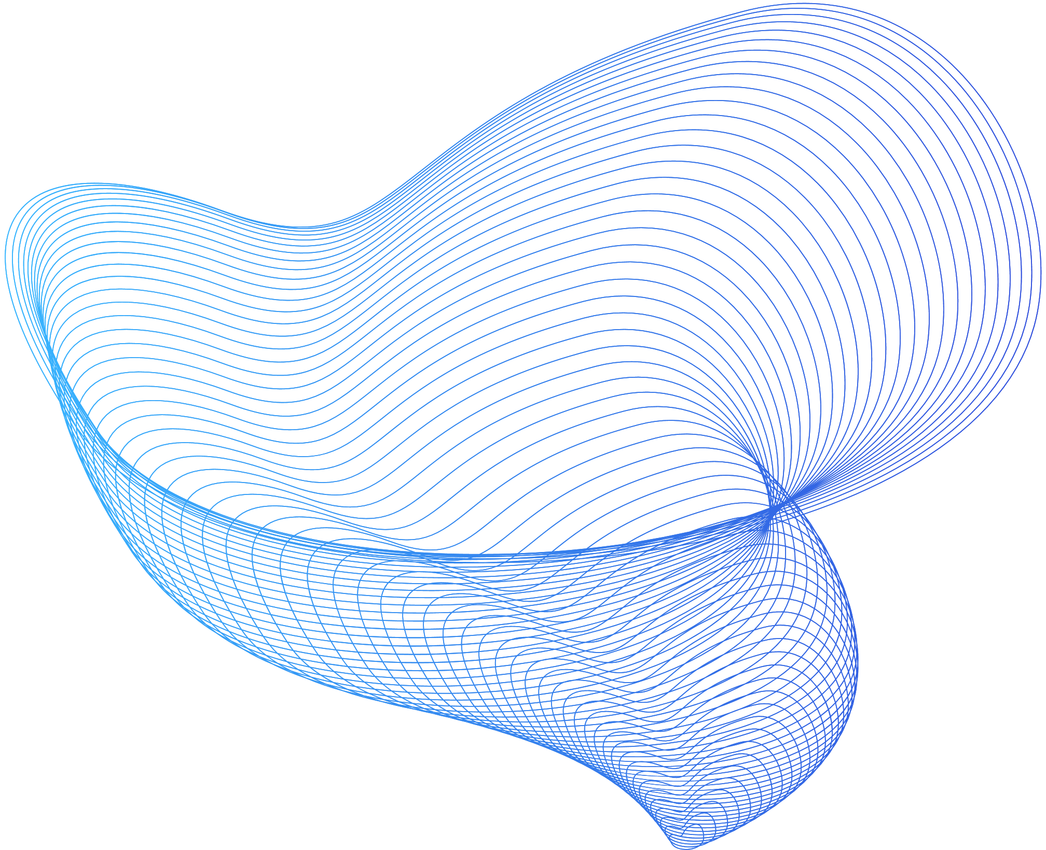
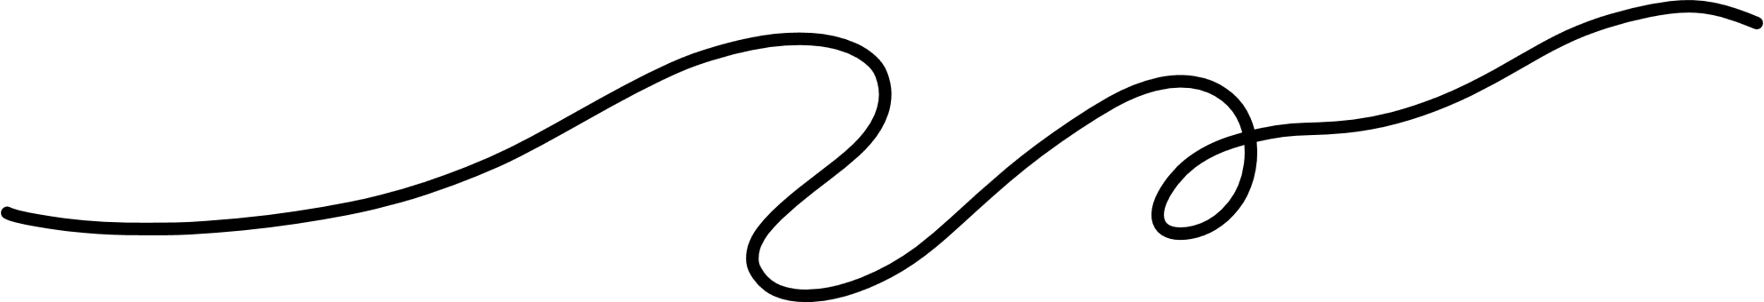

INTO THE FUTURE
OUR PRESENTATION
Presented by :
Ismael Ounni
Mohammed El Habachi

Slide 2
TABLE OF CONTENTS
Introduction
Community Goals
Personal Goals
Conclusion

Slide 3
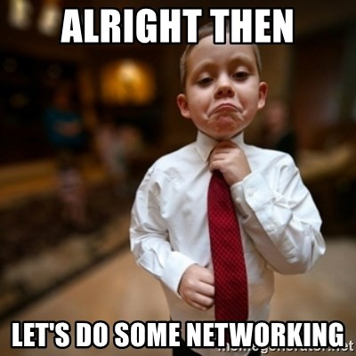
INTRODUCTION
Hello everyone, this is Ismail Ounni and Mohammed El Habachi.
We are students at the MERN FullStack developer Bootcamp. we are here today to talk about our common goals and our personal goals as MERN developers.

Slide 4
OUR COMMON GOALS
As a part of MERN developers community, we have a number of goals that we want to achieve. These goals include:
Learning and mastering the MERN stack
Building a strong community of MERN developers
Sharing knowledge and helping each other learn
Achieving these goals requires dedication, collaboration, and a passion for continuous learning, making our community of MERN developers an inspiring and dynamic group to be a part of.

Slide 5
OUR PERSONAL GOALS
In addition to our common goals, we also have a number of personal goals that we want to achieve.
My goals include:
Building mini projects
Join coding communities or forums
Learn other technologies

Slide 6
Shifting to my personal goals:
Land a job as a developer.
Continue to learn and grow as a developer
Contribute to open source projects.
We believe that by setting ambitious goals for ourselves, we can push ourselves to be the best developers that we can be.

Slide 7
CONCLUSION
In conclusion, we are a community of MERN developers who are passionate about learning and mastering the MERN stack. We have a number of goals that we want to achieve, both as a community and as individuals. We believe that by working together, we can achieve these goals and make a significant impact on the world of web development.

Slide 8
Thank you for listening.

